Slide 1
JMJ Medical Inc
Tomorrow’s tech in today’s care

Slide 2
What’s the value?
For clinic owners and doctors, who don’t have an efficient way to recall patients for high incentive billing opportunities and care gaps, JMJ Medical provides an automated product to increase revenue and allow clinics to offer preventative care without added administrative workload.

Slide 3
How does it work?
Our product is compatible with all EMR platforms
Provide us with your EMR login
Provide us with your official email access
Let us know which patient demographic to recall (ie complex care patients, 14050 CDM patients, patients with care gaps as per guidelines, etc)
Review standardized email templates

Slide 4
Backend
Our product will automatically generate the list of requested patients to recall from the EMR
An email template reviewed by the physician will be sent to all indicated patients through the clinic’s official email
They will be asked to call the clinic to book an appointment for the purpose indicated within the email
The content of the email will be password protected to ensure privacy and security

Slide 5
Results collected from a client GP in Vancouver
1,220 minutes in total were spent seeing the patients identified and recalled by our service. This equates to 1,220 minutes for $11,375.00 in revenue
Without our prioritization service, doctors primarily see walk-in patients for a common in office visit of $35.00 per patient on average
Each walk-in visit on average lasts 10 minutes (may vary depending on physician), 3250 minutes is needed to generate $11,375.00, vs 1,220 minutes resulting from our service

Slide 6
Results collected from a client GP in Vancouver
73 patients were seen as a result of our service (in those 1,220 minutes)
With 10 minutes per walk-in visit, and $35 per visit on average, 325 patients would have needed to be seen to match the impact of our prioritization service

Slide 7
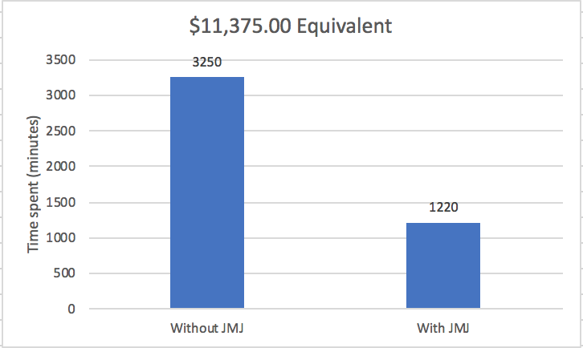
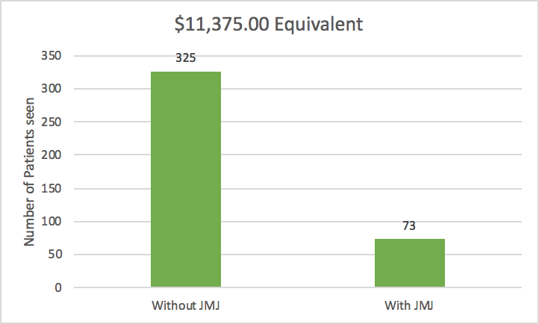
Visual Results
Time Saved
Patients seen

Slide 8




Clients

Slide 9
Contact
jorden@jmjmedical.ca
danny.lo@jmjmedical.ca
michael@jmjmedical.ca

